Slide 1
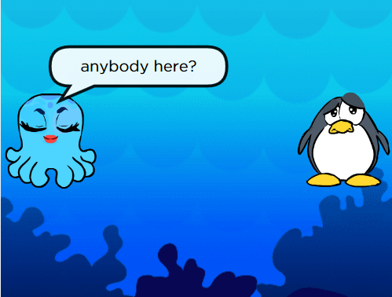
Stage 16: Play Lab: Create a Story

Slide 2
Objectives
Students will:
Identify actions that correlate to input events
Create an animated, interactive story using sequence, loops, and event-handlers
Share a creative artifact with other students

Slide 3
Example
Example: You must make a storyline by arranging the given directions in order

Slide 4
Directions
Complete Stage 16: Play Lab: Create a Story
Progress your way through the stage

